Slide 1

Multimedia Data Management
Lecture 8 – Procedures / Triggers
Fall 2022

Slide 2
Aside from the attributes on the tables, we may need to implement functionalities in our database.
Notes:
We had some example functions in Django models.

Slide 3
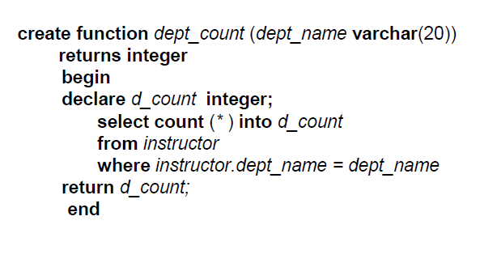
SQL Functions
Define a function that, given the name of a department, returns the count of the number of instructors in that department:

Slide 4
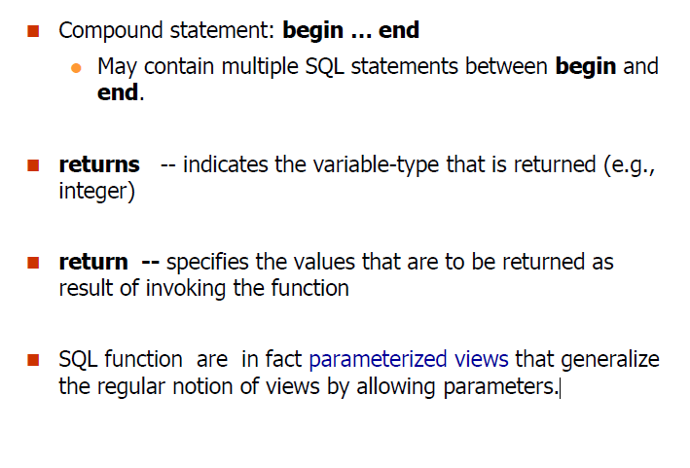
SQL Functions

Slide 5
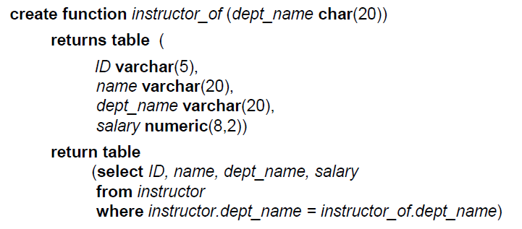
Table Functions
They are SQL functions that return a relation as their result.
Return all instructors in a given department

Slide 6
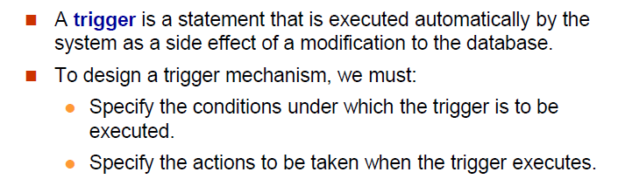
SQL Triggers

Slide 7
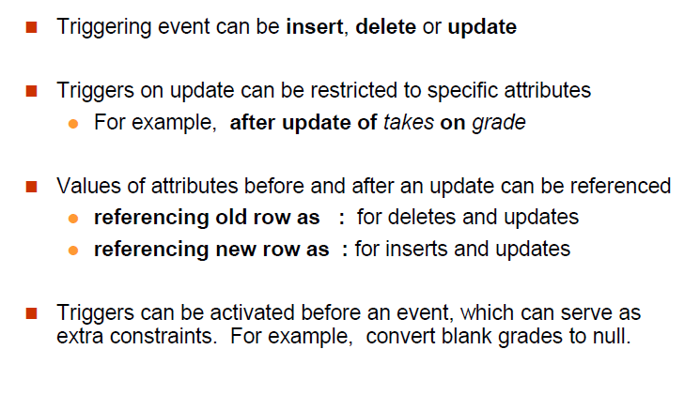
SQL Triggers

Slide 8
Trigger Example
CREATE TRIGGER setnull BEFORE UPDATE ON takes
REFERENCING NEW ROW AS nrow
FOR EACH ROW
WHEN (nrow.grade=‘ ’)
BEGIN ATOMIC
SET nrow.grade = null;
END;
Notes:
Using set Statement

Slide 9
Trigger Example
CREATE TRIGGER timeslot_check1 AFTER INSERT ON section
REFERENCING NEW ROW AS nrow
FOR EACH ROW
WHEN (nrow.time_slot_id NOT IN (
SELECT time_slot_id
FROM time_slot))
BEGIN
ROLLBACK
END;
Notes:
Maintain Referential Integrity

Slide 10
Trigger Example
CREATE TRIGGER credits_earned AFTER UPDATE OF takes ON (grade)
REFERENCING NEW ROW AS nrow
REFERENCING OLD ROW AS orow
FOR EACH ROW
WHEN nrow.grade <> ‘F’ AND nrow.grade IS NOT NULL
AND (orow.grade = ‘F’ OR orow.grade IS NULL)
BEGIN ATOMIC
UPDATE student
SET tot_cred = tot_cred +
(SELECT credits
FROM course
WHERE course.course_id = nrow.course_id)
WHERE student.id = nrow.id;
END;
Notes:
Maintain credits_earned value

Slide 11
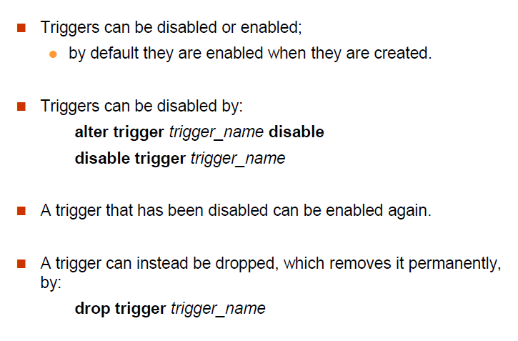
Disabling Triggers

Slide 12
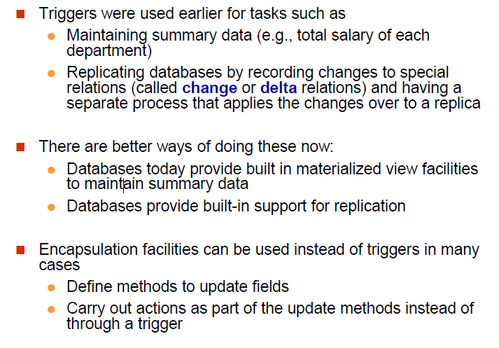
Misusing Triggers

Slide 13
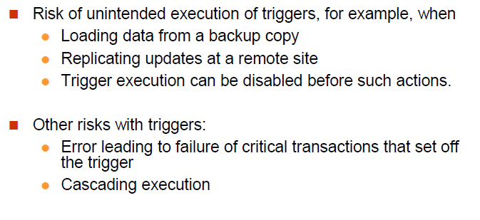
Misusing Triggers

Slide 14
Function Example
Write a function to return the number of products with an average rating above certain threshold.

Slide 15
Function Example
Write a function that updates a product name.

Slide 16
Function Example
Write a function that takes an order_id and returns its detail.
(What kind of function should we use?)

Slide 17
Trigger Example
For PostgreSQL, it is common to write trigger functions using one programming languages of PostgreSQL, then call them on trigger events.
Write a Trigger that automatically stores the date for submitted orders.

Slide 18
Trigger Example
When an order is already shipped, it should not be possible to change shipment status from TRUE to FALSE.
Create a Trigger to guarantee that situation.

Slide 19
References
Database System Concepts - 6th edition (db-book.com)

